Slide 1
QUICK SORT VISUALIZATION
Vidyavardhini’s College of Engineering & Technology
K.T. Marg, Vartak College Campus, Vasai Rd, Vasai-Virar, Maharashtra 401202
Department of Computer Science and Engineeering [Data Science]
Group No: 03
Nikhil Zore Roll No:63
Shardul Brid Roll No:64
Swayam Chaudhary Roll No 65
Guide: Sumeet Shingi
Date: 03/04/2024

Slide 2
Contents
Introduction
Problem Statement
Literature Survey
Proposed System
Algorithm
Details of Hardware/Software used
Output
Result Analysis
Conclusion
References
Thank you

Slide 3
Introduction
Quick Sort is a divide and conquer sorting algorithm having average time complexity as O(n log n).
Splitting is done by considering a element a pivot and comparing and swapping the pivot with other elements such that elements on left will be less and right elements will be greater than pivot .
Merging is done when the array is divided into unit array element after recursive partition , considering each element and adding to new array in a sorted way .
Our project will help you in understanding the algorithm in a visual way , From selection of pivot element to comparing and displaying the final array.

Slide 4
Problem Statement
Quick Sort stands out for its speed and elegance. However, understanding the intricacies of Quick Sort can be challenging, especially for those new to the world of algorithms and programming.
The problem at hand is to create an educational resource that addresses this challenge by providing a clear and intuitive understanding of Quick Sort through visualization and Python implementation .
The tool should visualize pivot selection , user controlled steps ,user input interaction.

Slide 5
Literature Survey
Sr.NO | Paper Title | Advantages | Disadvantages
01 | GPUTeraSort: high performance graphics co-processor sorting for large database management database management Naga Govindaraju , Jim Gray , Ritesh Kumar , Dinesh Manocha. SIGMOD/PODS06: International Conference on Management of Data and Symposium on Principles Database and Systems Chicago IL USA June 27 - 29, 2006. DOI:10.1145/1142473.1142511 | Accelerated sorting for large databases enhancing performance. | Increased power consumption complexity in system design
02 | GPU-Quicksort: A practical Quicksort algorithm for graphics processors Daniel Cederman , Philippas Tsigas .5 January 2010.ACM Journal of Experimental Algorithmics Volume 14Article No.: 4pp 1.4–1.24 DOI : 10.1145/1498698.1564500 | High parallelism leveraged for faster sorting on GPU. | Limited by GPU memory capacity and overhead in data transfer.

Slide 6
Sr.No | Paper Title | Advantages | Disadvantages
03 | COMPARATIVE STUDY OF TWO DIVIDE AND CONQUER SORTING ALGORITHMS: QUICKSORT AND MERGESORT Oluwakemi Christiana Abikoye,Aderonke Anthonia Kayode,AKANDE NOAH OLUWATOBI,Esau Oladipupo .January 2020.Procedia Computer Science 171:2532-2540 ,DOI:10.1016/j.procs.2020.04.27 | In-place sorting, often faster in practice for small datasets | Worst-case time complexity of O(n^2) and not stable.
04 | MQ Sort an Innovative Algorithm using Quick Sort and Merge Sort Renu Renu , Manisha Manisha . July 2015 International Journal of Computer Applications 122(21):10-14 DOI:10.5120/21847-5155n | improved worst-case time complexity | increased space complexity due to auxiliary arrays.
05 | Analysis of Fast Parallel Sorting Algorithms for GPU Architectures Publisher: Fiaz Gul Khan; Omar Usman Khan; Bartolomeo Montrucchio; Paolo Giaccone Published in: 2011 Frontiers of Information Technology,Date Added to IEEE Xplore: 23 January 2012 DOI: 10.1109/FIT.2011.39 | Enhanced speed and scalability for sorting large datasets. | Complexity of implementation and limited applicability to certain problem sizes or types.

Slide 7
Proposed system
The proposed system is a Quick Sort Visualization Tool, designed to provide users with a dynamic and educational experience of the Quick Sort algorithm. This tool will offer a visually engaging representation of the sorting process, allowing users to interact with and comprehend the steps involved in Quick Sort.
Key Components:
1. User Interface
Input Controls: Users can input an array of elements that need to be sorted using Quick Sort.
Visualization Window: Displays the dynamic visualization of the Quick Sort algorithm, showcasing the array elements and the sorting process.
Algorithm Engine
Quick Sort Implementation: A robust implementation of the Quick Sort algorithm that accurately partitions and sorts the input array
Step-by-Step Execution: The algorithm should be designed to execute in a step-by-step manner, allowing the visualization tool to capture each stage of the sorting process.

Slide 8
3. User Interaction
Play/Pause Controls: Users can start, pause, or resume the visualization at any point to observe the sorting process at their own pace.
4. Educational Features
Highlighting Partitioning Steps: Emphasize the crucial steps of partitioning in the Quick Sort algorithm, aiding in understanding the divide-and-conquer strategy.
Real-time Statistics: Display real-time statistics, such as comparisons and swaps, to provide insights into the efficiency of Quick Sort.

Slide 9
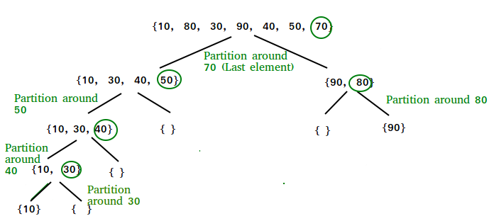
Algorithm(Quick Sort)

Slide 10
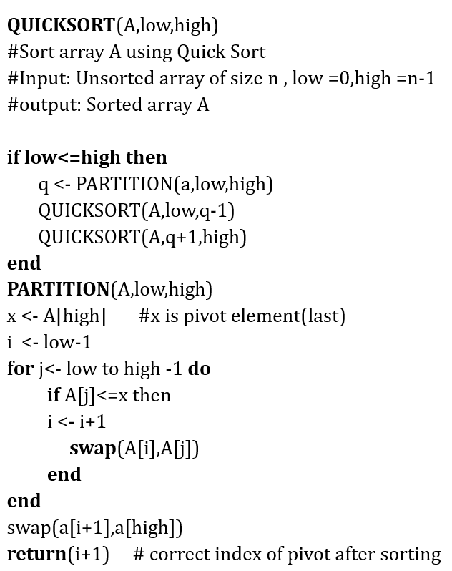

Slide 11
Details of Hardware/Software used
HARDWARE :
Processor: AMD Ryzen 3
RAM: 128 GB
Hard Disk: 1TB
SOFTWARE:
Integrated Developement Enviroment(IDE) :Pycharm
Operating System :Windows 11, version 23H2
Programming Language:
Python
Python Libraries :
matplotlib . pyplot
matplotlib . widgets
numpy

Slide 12
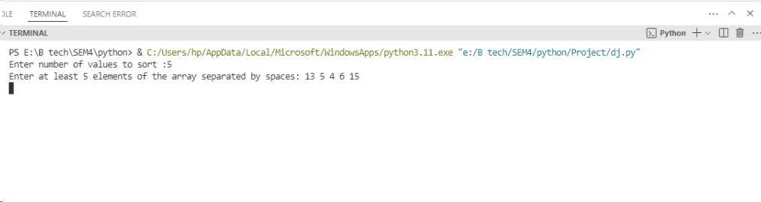
Output
Initialization step ,taking no of elements and elements as input from user .
STEP1 : Initialization

Slide 13
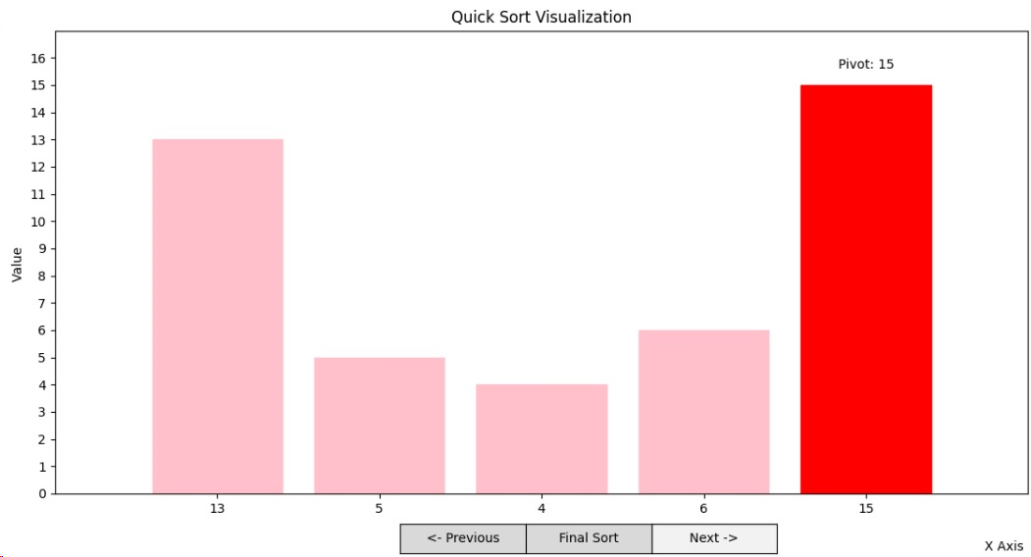
Taking the last element 15 as pivot and will compare with rest of elements such that all elements less than 15 will be on left and greater than on right side . Since all elements on left are lesser no change will be seen
STEP2: First pivot 15

Slide 14
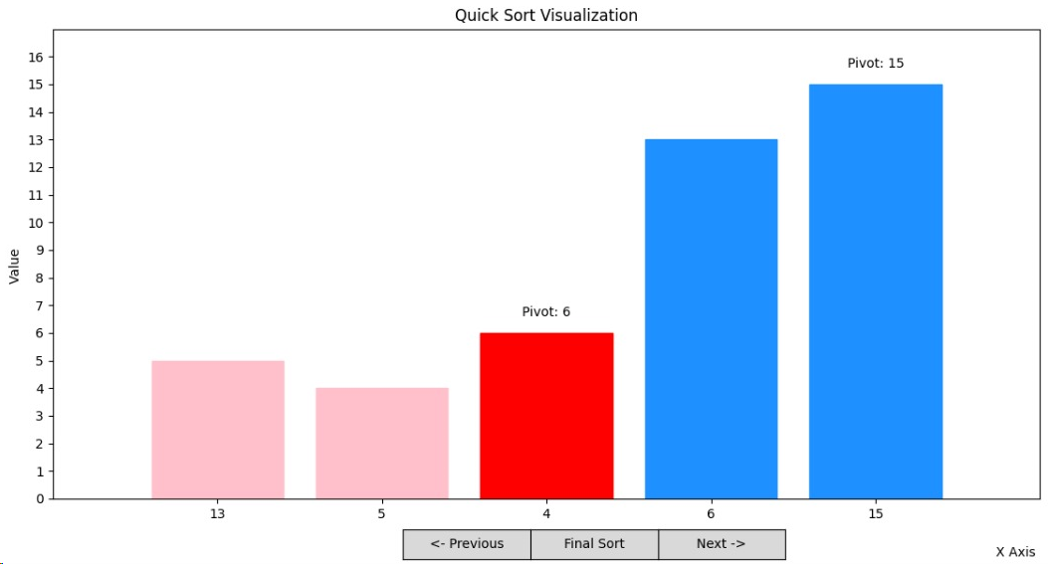
Since no changes previous element 6 will be chosen as pivot , comparing we get 13 greater so it will be right side rest on left side .
STEP 3: SECOND PIVOT 6

Slide 15
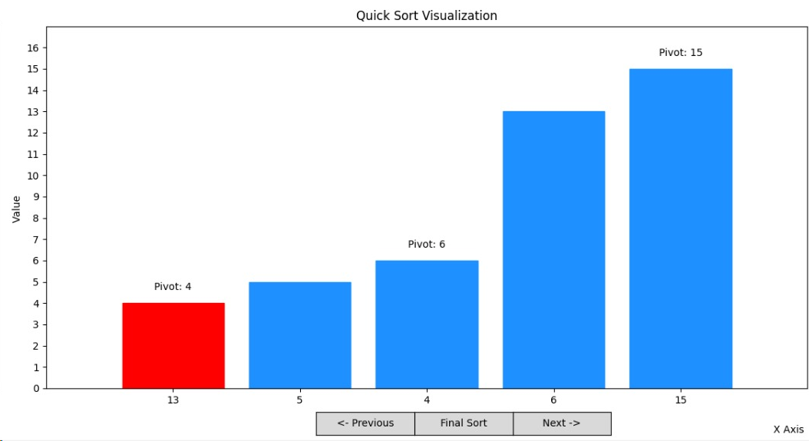
After partition the last element will be 4 so it will be selected as pivot and comparing 5 will be on right side and hence it will be our last pivot, we will get our final sorted array.
STEP4:THIRD PIVOT 4

Slide 16
Result Analysis
Visualization Effectiveness :
The project shows excellent visual representation of Quick Sort algorithm .It shows separate colours for sorted(LIGHT BLUE) ,unsorted(PINK) and pivot (RED).
Elements are displayed in bar graph format ,labelled pivot element.
User understanding :
It works with under user input and ability to step through the sorting process incrementally or directly sort to the final result provides flexibility for users.
User can clearly understand the swapping of bar graphs on changing pivot element .
Suggestion : Implement error handling for non-integer values , empty array.
Outcome :
The project sorts the input elements showing their effective visualization .

Slide 17
Conclusion
The development of the Quick Sort Visualization Tool has achieved its goal providing users with a dynamic and educational experience in understanding the Quick Sort algorithm.
It’s user-friendly interface allows users to input arrays, witness the step-by-step execution of the Quick Sort algorithm, and interact with the visualization at their own pace.
In addition to its educational value, the Quick Sort Visualization Tool serves valuable resource for students, educators, and enthusiasts seeking a hands-on understanding of sorting algorithms.

Slide 18
Future Scope
Working on error handling for non-integer values , empty arrays.
Different pivot selection options(FRONT, MID ,BACK).
Rectifying the condition of larger element as pivot .
Explanation for each step.

Slide 19
References
[1] Oluwakemi Christiana Abikoye , Aderonke Anthonia Kayode , AKANDE NOAH OLUWATOBI , Esau Oladipupo . “Comparative study of two divide and conquer sorting algorithms : Quick Sort Merge Sort “Procedia Computer Science 171:2532-2540DOI:10.1016/j.procs.2020.04.274
[2] Daniel Cederman , Philippas Tsigas .” GPU-Quicksort: A practical Quicksort algorithm for graphics processors” ACM Journal of Experimental Algorithmics Volume 14Article No.: 4pp 1.4–1.24 DOI : 10.1145/1498698.1564500
[3] Naga Govindaraju , Jim Gray , Ritesh Kumar , Dinesh Manocha.”GPU-Quicksort: A practical Quicksort algorithm for graphics processors” .SIGMOD/PODS06: International Conference on Management of Data and Symposium on Principles Database and Systems Chicago IL USA June 27 - 29, 2006.DOI:10.1145/1142473.1142511
[4] Renu Renu , Manisha Manisha .“MQ Sort an Innovative Algorithm using Quick Sort and Merge Sort”. International Journal of Computer Applications 122(21):10-14 DOI:10.5120/21847-5155n
[5] Fiaz Gul Khan; Omar Usman Khan; Bartolomeo Montrucchio; Paolo Giaccone “Analysis of Fast Parallel Sorting Algorithms for GPU Architectures Publisher” Added to IEEE Xplore: 23 January 2012DOI: 10.1109/FIT.2011.39

Slide 20
Thank you

